Slide 1




Spotlight on Farm Safety, Health, & Wellness Toolkit for Managing Farm Stress and Mental Health
Presented by:
Garland Mason, Program Coordinator AgrAbility Virginia*
Nicole Nunoo, Graduate Research Assistant*
Kim Niewolny, Director AgrAbility Virginia & Virginia Beginning Farmer and Rancher Coalition*
*Department of Agricultural, Leadership, and Community Education, Virginia Tech
Welcome! Be sure to connect to audio using your computer or phone so you can hear the presenters.

Slide 2


Technical Logistics
ZOOM Webinar
Participants are muted and participant video is off.
To comment or ask questions, please use the chat feature →
Click the chat icon at the bottom of your zoom screen. Then type in the chat window that appears.
Quick Chat Hello
Please share where you are tuning in from and a word or phrase sharing what you hope to learn today

Slide 3
This webinar will be recorded and posted to the extension listserv and to the Beginning Farmer and AgrAbility websites:
https://www.vabeginningfarmer.org/
http://agrabilityvirginia.org/

Slide 4
Spotlight on Farm Safety, Health, & Wellness Toolkit for Managing Farm Stress and Mental Health
Presented by:
Garland Mason, Program Coordinator AgrAbility Virginia*
Nicole Nunoo, Graduate Research Assistant*
Kim Niewolny, Director AgrAbility Virginia & Virginia Beginning Farmer and Rancher Coalition*
*Department of Agricultural, Leadership, and Community Education, Virginia Tech

Slide 5
Farm Safety, Health, & Wellness Initiative
Partnership between:
  VA Beginning Farmer & Rancher Coalition Program
  AgrAbility Virginia
  VSU Small Farm Outreach Program
  VCE Human Development Program Team
  VCE Dairy Agent Expertise
  With partners (VDACS, Farm Bureau, Farmer Veteran Coalition, Mary Baldwin University, & University of Kentucky)
Funding provided by:
  “Reducing Human & Financial Risk for Beginning, Military Veteran, & Historically Underserved Farmers through Farm Stress, Wellness, & Safety Education,” Southern Extension Risk Management Education
Focus on Farm Stress and Mental Health
“This is important because there are a lot of farmers and people who interact with them, and this is a challenging subject—it’s not one people want to talk about” -Jeremy Daubert, VCE agent in Rockingham County and AgrAbility Virginia

Slide 6
Farm Safety, Health, and Wellness Initiative
Aims & Activities:
  Develop educational resources (as toolkit) on the related topics of farm-life stress, managing farm financials, and on-farm safety.
  Develop culturally appropriate and site-specific case studies and decision-making tools of farmers and farmer educators experiencing and addressing farm-related stress
  Design and deliver Farm Dinner Theaters in two communities.
  Implement webinar series on farm stress and on-farm safety issues for farmers and educators.
  Offer in-services for educators on the issues and use of toolkit.

Slide 7
Farm Safety, Health, and Wellness Resources
Best Practices to Managing Farm Financial Health and Wellbeing
  https://www.pubs.ext.vt.edu/content/dam/pubs_ext_vt_edu/ALCE/alce-222/ALCE-222.pdf
Managing Farm Financial Stress for a Healthy Farm and a Healthy Farm Family
  https://www.pubs.ext.vt.edu/ALCE/ALCE-220/ALCE-220.html
Farm Financial Stress Assessment Tool for Farmer Advisors and Practitioners
  Link TBA
Farm Stress and Grief in the Time of COVID-19: Strategies and Resources
  https://www.pubs.ext.vt.edu/content/dam/pubs_ext_vt_edu/ALCE/alce-202/ALCE-202.pdf
Virginia Farm Emergency Plan
  https://www.pubs.ext.vt.edu/ALCE/ALCE-219/ALCE-219.html

Slide 8
Farm Safety, Health, and Wellness Resources
Five Mental Health Farmer Case Studies
  https://agrability.alce.vt.edu/publications/farm-safety-health-wellness.html
Decision-Making Guide for Farm Service Providers and Educators
  https://www.pubs.ext.vt.edu/content/dam/pubs_ext_vt_edu/ALCE/alce-187/ALCE-187.pdf
Communicating with Farmers under Stress & Weathering the Storm Trainings
  Communicating with Farmers: https://www.youtube.com/watch?v=w1cp-ZD2B3s&t=219s
  Weathering the Storm: https://www.youtube.com/watch?v=NuxbpZKWGSU
Farm Safety Dinner Theatres (Madison and Russell County)
VA Farm Stress Taskforce Coping with Stress in the Ag. Community Brochure
  https://www.vdacs.virginia.gov/pdf/farmer-stress-brochure.pdf

Slide 9
Framing the Issues
The farm economy is in crisis, and farmers are under immense stress, due to volatile and unpredictable nature of farming. Farmers, particularly minority farmers, encounter various threats:
  Social (family, community), economic (land loss, financial stress), political (systemic discrimination, racism, policy), and environmental (droughts, floods, pest infestation)
  Affect the mental health and general well-being of farmers (Braun, & Pippidis, 2020).

Slide 10
Motivation
Farm financial situations, specifically, may cause stress and depression
  Given limited mental health professionals, farmers are at risk to take drastic measures in addressing their mental health and well-being.
  Not only do these measures determine the health of the farm, business, or operation – they affect the health of the farmer and his/her family.

Slide 11
Farm Stress and Mental Health
  In 2018, Farm Aid reported more than a thousand farmers in the United States dialed their crisis hotline
  Over 450 farmers died by suicide across nine midwestern states between 2014 to 2018.
  The Department of Health and Human Services noted that about 111 million people lived in areas, mainly rural areas, with a shortage of mental health professionals.

Slide 12
Farm Stress and Mental Health
  In Virginia, a nationwide survey conducted by the American Foundation for Suicide prevention (2020) found that, suicide was the 10th leading cause of death particularly in the Appalachian region (Carroll, 2019).
  Virginia does not have an exact number of farmers who have died by suicide. According to the Center for Disease Control (CDC), this could be attributed to the fact that some suicides are easily reported as farm-related accidents and hence there may be more farmers dying by suicide that reported (Jared, 2019).

Slide 13
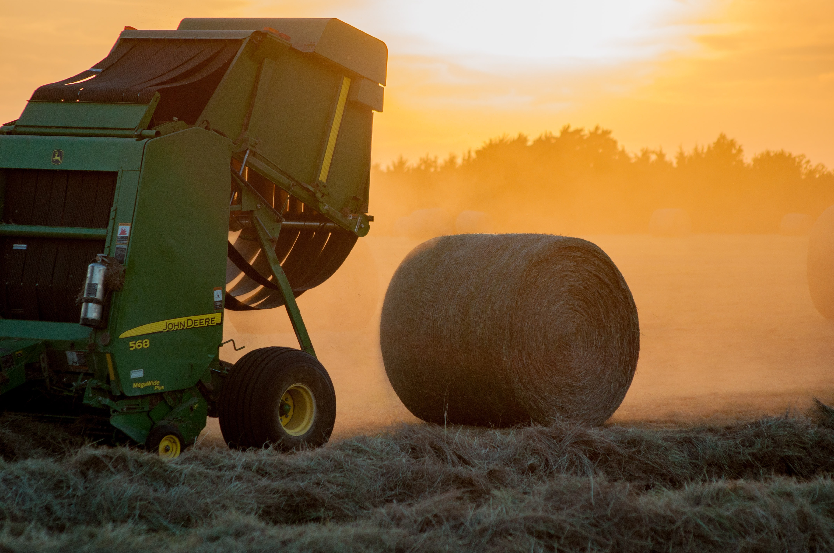
Best Practices to Managing Farm Financial Health and Wellbeing
Aimed for farmers to manage finances
Can serve as a reference sheet for agents and educators working with farmers
Available at:
  https://www.pubs.ext.vt.edu/content/dam/pubs_ext_vt_edu/ALCE/alce-222/ALCE-222.pdf
Image credit: Jed Owen on Unsplash

Slide 14
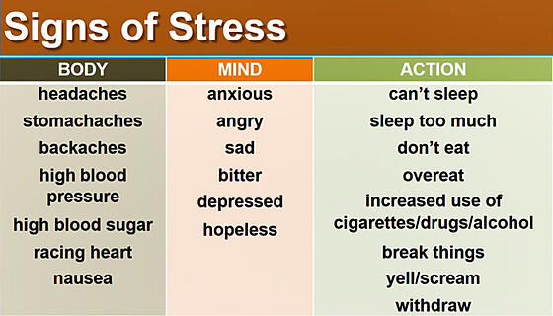
Managing Farm Financial Stress for a Healthy Farm and a Healthy Farm Family
In-depth piece on farm financial stress and how it impacts mental health
Descriptions of what constitutes a financially healthy farm, breaks down components of assessing farm financial health
Describes indicators and causes of farm financial stress
Communicating with farmers under stress
Extensive list of resources
Available at:
https://www.pubs.ext.vt.edu/ALCE/ALCE-220/ALCE-220.html
Image credit: https://emergence.fbn.com/

Slide 15
Farm Financial Stress Assessment Tool for Farmer Advisors and Practitioners
Assessment tool is a communication aid for discussing mental health concerns with farmers
Includes sections on:
  Advice from practitioners on discussing sensitive topics such as farm finance and mental health
  Conversations with diverse audiences, talking across boundaries of gender, race and age
  How to foster supportive conversations about farm finance
Webinar from 9.9 posted on the VBFRC and AgrAbility websites
Link to article TBA

Slide 16

Farm Stress and Grief in the Time of COVID-19: Strategies and Resources
Coronavirus & stress
Provides specific coping strategies to deal with stress and anxiety
Mental Health Resources in Virginia and Nationally
COVID-19 Mental Health Resources & News Articles
Available at: https://www.pubs.ext.vt.edu/content/dam/pubs_ext_vt_edu/ALCE/alce-202/ALCE-202.pdf
Image credit: Amanda Northrup/Vox

Slide 17

Virginia Farm Emergency Plan
Provides a template for creating a customized emergency plan for farms
Information on:
  Why an emergency plan is important
  Where to store and display an emergency plan
  Who should know about and be able to access an emergency plan
  What to include in an emergency plan
Available at: https://www.pubs.ext.vt.edu/ALCE/ALCE-219/ALCE-219.html
Image credit:
Mitchell Luo on Unsplash

Slide 18

Five Mental Health Farmer Case Studies
Five case studies developed in partnership Mary Baldwin University’s Murphy Deming College of Health Sciences
  Dunlap's Beef Cattle: The Impact of Intergenerational Farm Transfer
  Financial Strain on Dairy Farmers: The Cooper Family Story
  The Johnsons' Broiler Farm
  The Montel Family: An Intergenerational Farm
  The Family Vegetable Farm in Roanoke, Virginia
Available at https://agrability.alce.vt.edu/publications/farm-safety-health-wellness.html

Slide 19
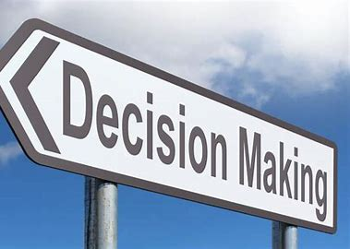
Decision-Making Guide for Service Providers & Educators
Examples of stressors, warning signs, advice and tips for practitioners on how to help
Examples of farm resources, mental and physical health resources, and community referral resources.
Available at:
https://www.pubs.ext.vt.edu/content/dam/pubs_ext_vt_edu/ALCE/alce-187/ALCE-187.pdf
Image credit: Penn State ICDS

Slide 20
Communicating with Farmers under Stress
& Weathering the Storm Trainings
Trainings given throughout the state by VCE agents Cynthia Martel & Jeremy Daubert
Curriculum developed by Michigan State Extension aimed at practitioners & farmers
Recorded on YouTube:
  Communicating with Farmers:
    https://www.youtube.com/watch?v=w1cp-ZD2B3s&t=219s
  Weathering the Storm:
    https://www.youtube.com/watch?v=NuxbpZKWGSU

Slide 21
How to Communicate with Farmers Experiencing Stress
I hear you saying ____ (repeat back the main concerns the farmer is expressing).
This sounds like a lot to manage. How are you coping with this?
What can I do to support you?
Would it be helpful if we work together on an action plan for how to manage your concerns?
NOTE: Avoid statements such as: “don’t worry too much about it”, “everyone goes through these in life”, “don’t make a big deal out of it”, “it’s probably nothing to worry about”. Such statements are dismissive and likely to make the individual withdraw further.

Slide 22

Farm Safety Dinner Theatres
(Madison and Russell County)
Organized by VCE agents Brad Jarvis (Madison Co.) and Amy Byington (Russell Co.)
In Russell Co. on February 22, 2020 with 53 participants
  Scripts written by Lee FFA Members, adapted from Dr. Reed’s Farm Dinner Theatre Toolkit. Students took four weeks to research and write their play and also acted in the plays.
In Madison Co. on February 20th, 2020 with 75 participants
  Actors from the farm community, scripts adapted from Dr. Reed’s Farm Dinner Theatre Toolkit. Plays directed by Shirley Workman, local theater company.
Goal: to provide a relaxed environment in which farmers and their families can identify safety and stress issues; watch as these issues are processed by the actors while eating a meal. The theater gives the audience the opportunity to think about how they would react in the situations. The events were set up for open communication to occur among the audience and their families.

Slide 23
VA Farm Stress Taskforce Coping with Stress in the Ag. Community Brochure
Available at: https://www.vdacs.virginia.gov/pdf/farmer-stress-brochure.pdf

Slide 24
Farm Safety, Health, & Wellness Initiative Toolkit
Best Practices to Managing Farm Financial Health and Wellbeing
Managing Farm Financial Stress for a Healthy Farm and a Healthy Farm Family
Farm Financial Stress Assessment Tool for Farmer Advisors and Practitioners
Farm Stress and Grief in the Time of COVID-19: Strategies and Resources
Virginia Farm Emergency Plan
Five Mental Health Farmer Case Studies
Decision-Making Guide for Farm Service Providers and Educators
Communicating with Farmers under Stress & Weathering the Storm Trainings
Farm Safety Dinner Theatres (Madison and Russell County)
VA Farm Stress Taskforce Coping with Stress in the Ag. Community Brochure
Visit this webpage to find the collection of resources:
https://agrability.alce.vt.edu/publications/SafetyHealthWellness

Slide 25
Q & A Session
Directions
Please type your question in the chat feature→
Click the chat icon at the bottom of your zoom screen. Then type in the chat window that appears.

Slide 26

Upcoming webinar:
Mindfulness & Self-Care
for Farmers
September 30, 2020
1-2 pm

