Slide 1

Beginning Farmer Webinar
In order to participate in today’s webinar, please connect to audio using your computer or phone. You will not be able to hear the presenters without completing this step.

Slide 2


This webinar is being offered as part of a Southern Extension Risk Management Education grant, titled “Reducing Human and Financial Risk for Beginning, Military Veteran, and Historically Underserved Farmers through Farm Stress, Wellness, and Safety Education”

Slide 3
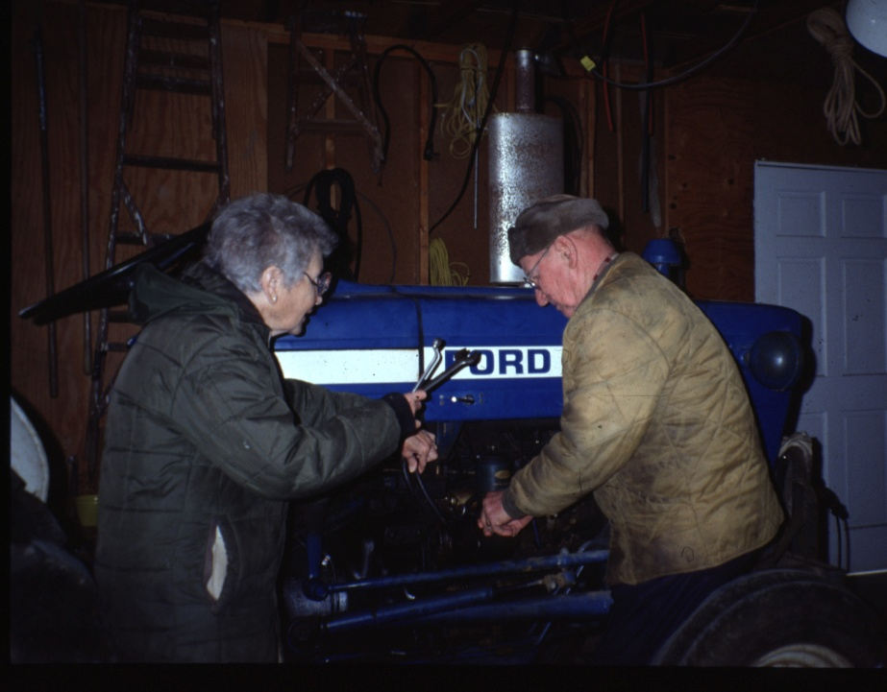
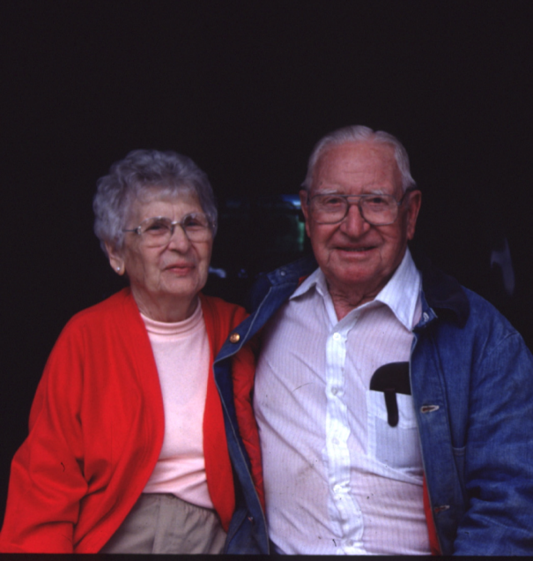

Protecting your health and safety as the years go by:
Deborah B. Reed, PhD, RN, FAAOHN
University of Kentucky College of Nursing
dbreed01@uky.edu
Notes:
Dr. Reed is a distinguished service professor and holds the Good Samaritan Endowed Chair in Community Health Nursing at UK. She has conducted funded agricultural health and safety research since 1991. Prior to that she was a home health and hospice nurse in rural KY.

Slide 4
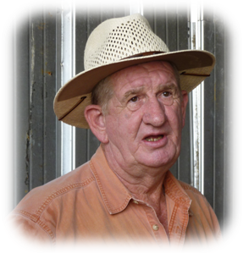
Magnitude of the Problem
Farming is among the top three most hazardous industries in the nation.
Older farmers have the highest fatality rates of any age group of farmers.
Farmers rarely retire completely from their work

Slide 5
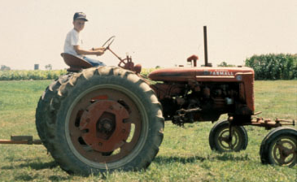
Objectives
Determine the difference between “normal and “abnormal” aging.
Apply age appropriate health and safety interventions.
Identify resources to assist farmers in their activities.
Notes:
Farming is usually a cradle to grave industry and work culture is ingrained at a young age. Young boy- old tractor is still a common sight, but most young adults leave the farm to work a “public” job full time. Many return to farm work after retiring from the “public” work, or they farm “on the side” – essentially holding two full time jobs.

Slide 6
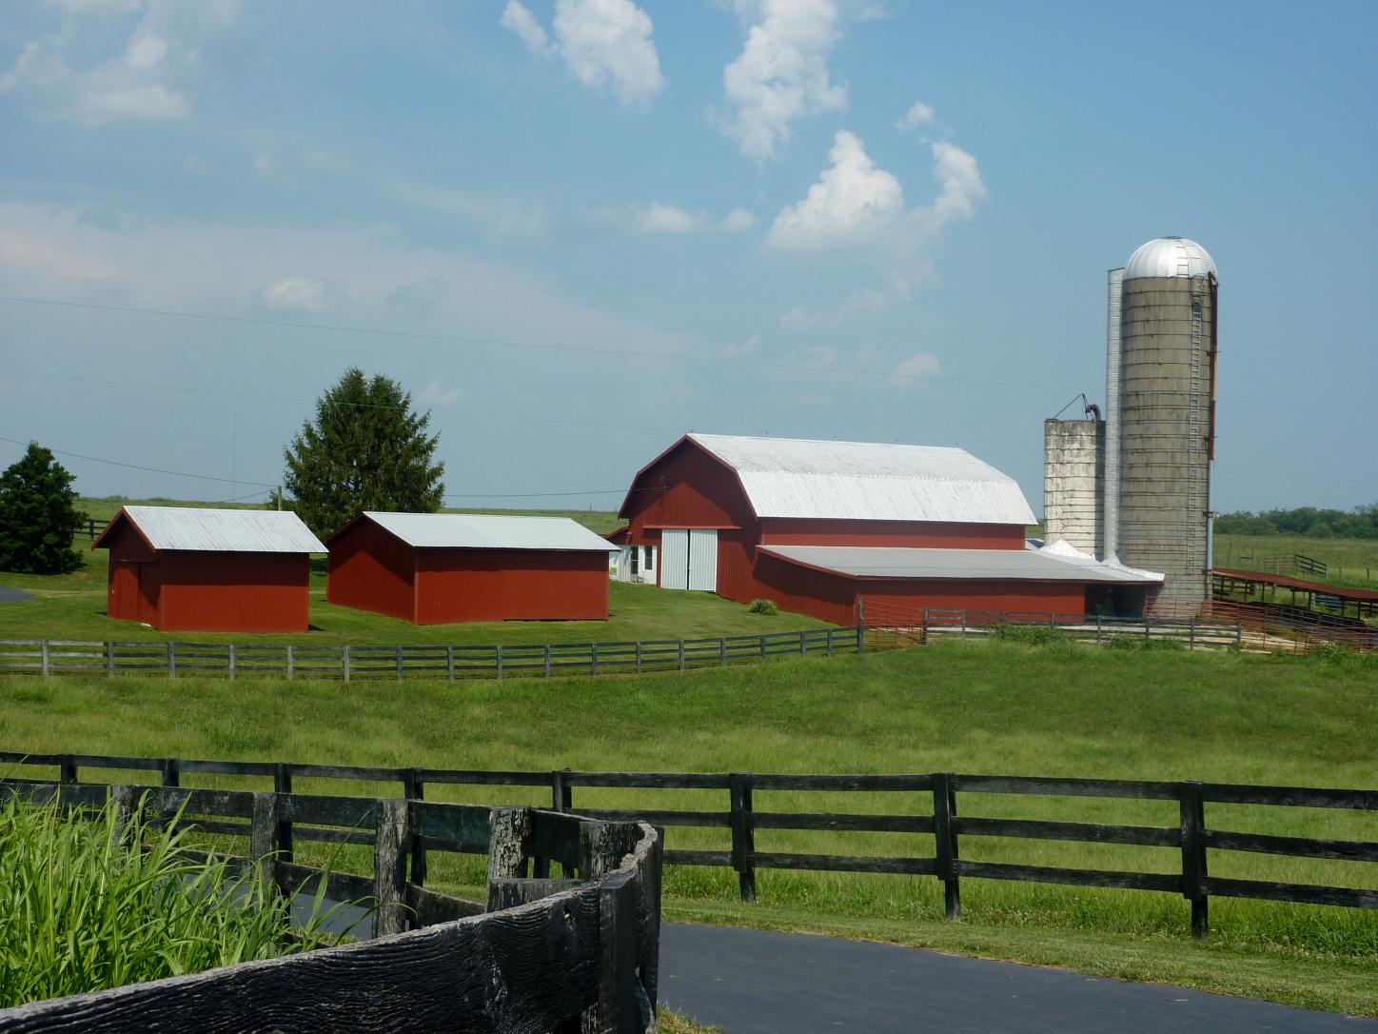
The Farm Workforce
most rapidly aging workforce in U.S.
average age of all U.S. principal farm operators 58.3; average age of the U.S. workforce is 42
not constrained by constructs typical to the labor force (no standard retirement age, performance evaluation criteria, or years of service)- no pension

Slide 7
Off-Farm Work
Mean Hours and Weeks
Source: Sustained Work Indicators of Older Farmers (Reed)
Notes:
This slide is from our data set of farmers ages 50 and over. You can see that off-farm work is full time and younger ages

Slide 8
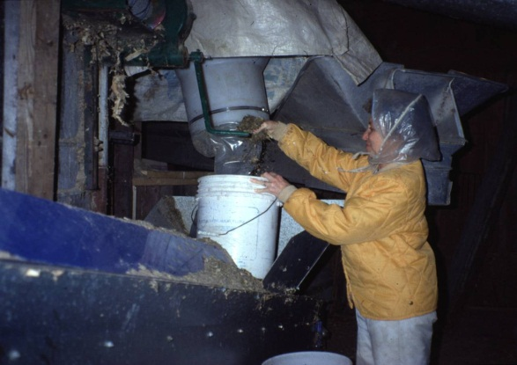
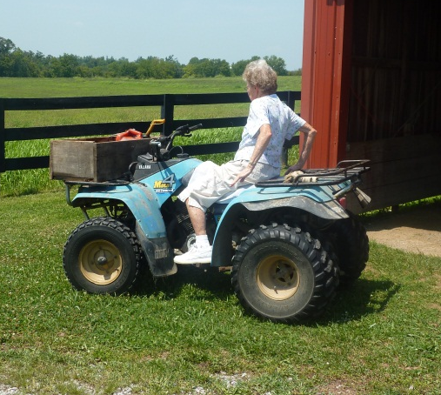
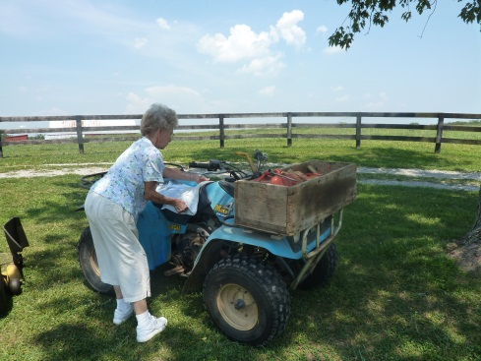
Persistence
“My Doctor, after I cut my leg off, he said just to sell the farm and retire. I was so mad, I’m not going to sell what we worked so hard for! This is what I do. This is who I am, I’ll find a way to do it. I have to.”
- DB, age 70, amputation at age 64
(now 77, still farming)
“It’s in the blood. We’ve always liked it. It’s part of who we are.”
Notes:
Are they hardy, resilient, stubborn, or trapped? All these terms have been used in the literature about farmers. This lifelong farmer has been through 4 prosthetic devices already and continues her farm work despite multiple health impairments. She is 4 10 and weighs 78 lbs.

Slide 9

Injuries and Aging
Injury rate of farmers 3 times higher than other occupations
Older farmers have less non-fatal injuries than younger
Fatality rate is 2.6 times greater than for younger farmers
Older farmers more likely to require hospitalization with a longer length of stay
Myers, J. R., Layne, L. A., & Marsh, S. M. (2009). Injuries and fatalities to US farmers and farm workers 55 years and older. American journal of industrial medicine, 52(3), 185-194.
Notes:
Tractors, trucks and animals led the mechanisms for most of these fatalities and falls are frequently involved in the injury events..
Reviews of injured farmer’s medical records note that older farmers are more likely to require hospitalization due to their injuries than younger farmers. A Canadian study confirmed that hospitalization costs for older injured famers were higher and length of stay longer than for younger farmers.
In the United States, the fatality rate for older farmers was 2.6 times greater than for younger farmers with a dramatic increase in fatalities beginning at age 65.(Myers)
Tractors without safety devices – such as this one without a roll-bar, seatbelt, or steps, place farmers at greater risk for falls.

Slide 10
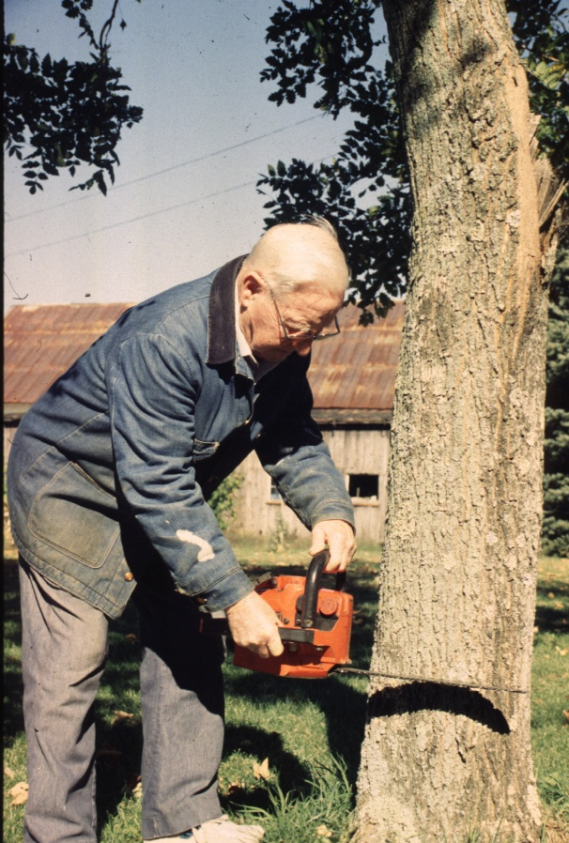
Ag Injuries Among KY Older Farmers (N=998)
Crude injury rate 9.03 (CI=7.03,11.03)
Falls (24.9%), machinery (22.5%),
wood-cutting (14.6%), animals (14.3%)
Beef cattle only farms OR =1.90 (1.02,3.55)
Beef/tobacco OR= 2.15 (1.00-4.59)
Source: Browning et al, 1998
Notes:
In Kentucky, this large study found that KY farmers over age 55 had elevated risks of injury if they lived or worked on beef cattle farms or beef and tobacco operations. These injuries were often very serious. A limitation to the study was that only survivors were interviewed. How do these figures compare to the previous slide? Based on these data where would you place emphasis?

Slide 11
Perceived Farm Work Hazards to the Older Farmer
per the Farmers
per Family Members
Balance, vision, arthritis, hearing
Long hours
Working alone
Driving equipment on highway
Stress
Equipment
Cattle
Chainsaws
Stress
Study: Safety Strategies for Older Adult Farmers
Notes:
The older farmers did not perceive the dangers associated with aging factors toward themselves, only toward their fathers. They realize their physical and mental capabilities aren’t what they once were but don’t see those factors as significant increases for injury risk right now. None of the farmers in this group really perceived their aging issues as hazards on the farm – when asked about the hazards it was always the equipment or the cattle. Finite things that served as the injury host, not anything related to them.
Even though they understand the risks increase as they develop aging symptoms, they still seem to think it won’t happen to them. Still seem to think they can control their circumstances and events. Or maybe they just think it’s worth the risk to do what they love to do.
Interesting that they all expressed how much easier farming is physically now than it was when they started but that the stress level is greater. In the long run, wonder which will place a greater toll on the farmer? I would guess the latter. Literature already supports how stress is a major factor contributing to injury. Aches and pains can be controlled to some extent to let you carry on your work. But mental issues (worry, stress) will affect everything you do. Prevents you from thinking clearly and paying attention, etc.

Slide 12
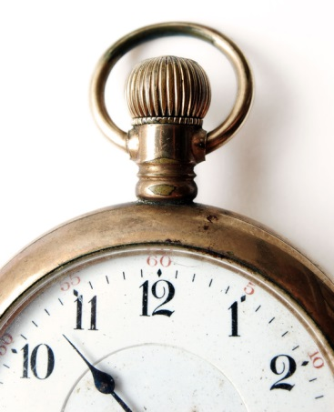
What happens as we age
AKA: “the groan”
Decreased respiratory capacity – 20’s
Presbyopia – 40’s
Compromised joints – 50’s
Skin changes – 60’s
Decreased distal sensation – 70’s
Decreased temperature tolerance – 80’s
Notes:
Aging starts at birth, the good news is we get wiser as we age and can accommodate these deficits
In the public workplace, most often noticed is compromised joints back strains etc

Slide 13

Leading Health Conditions
Reported by Older Farmers (n=1,423)
Source: Sustained Work Indicators of Older Farmers (Reed)
Notes:
The mean number of health conditions reported was 2.2. These conditions are consistent with the same age group in the general population but the physical demands of farming far surpass those of the general population. All of these chronic conditions are potentially serious and can interfere with the ability to perform work. 75% of the sample took at least one daily prescription medication.
Men reported more chronic conditions than women (contrary to general population).

Slide 14
Top 5 health conditions of older farmers by age group
Source: Sustained Work Indicators of Older Farmers (Reed)
Notes:
Note rise in MSD with advancing age. Hearing is probably woefully under-reported ( this is self report data).

Slide 15
Injury Rates Associated with Chronic Health Conditions
Rate of Injured Farmers per 100 observations
Health Condition | With Condition | Without Condition | Estimated Odds Ratio
Bronchitis or emphysema | 19.1 | 8.7 | 1.57
Back problems | 14.6 | 8.0 | 1.80
Arthritis, joint problems | 11.7 | 7.7 | 1.68
Source: Marcum, Browning, Reed, & Charnigo, 2011b

Slide 16
Injury Rates and Chronic Health Conditions
Rate of Injured Farmers per 100 observations
Health Condition | With Condition | Without Condition | Estimated Odds Ratio
Hearing problems | 13.9 | 8.1 | 1.63
Vision problems | 13.5 | 8.3 | 1.38
Heart attack/condition | 11.6 | 8.9 | 1.19
High blood pressure | 10.0 | 8.8 | 1.06
Source: Marcum, Browning, Reed, & Charnigo, 2011b

Slide 17
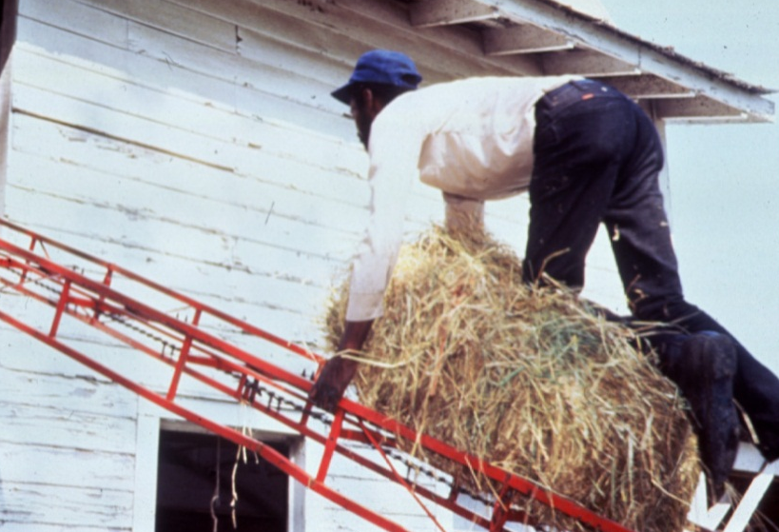
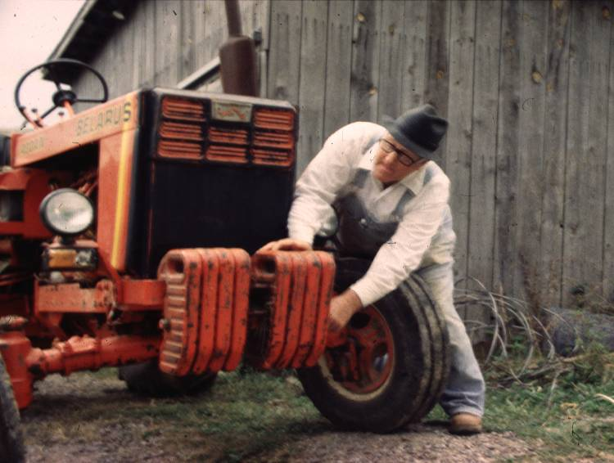
As age advances …
Prolonged recovery
Morbidity and mortality increases
Co-morbidities increase
Notes:
Have you noticed it takes longer to recover as you age, and with that, comes more illnesses. Because our systems are compromised it is more likely that we die form what we could have recovered form at an earlier stage in life. Thus, it becomes even more important to protect ourselves ( “ an ounce of prevention….)

Slide 18
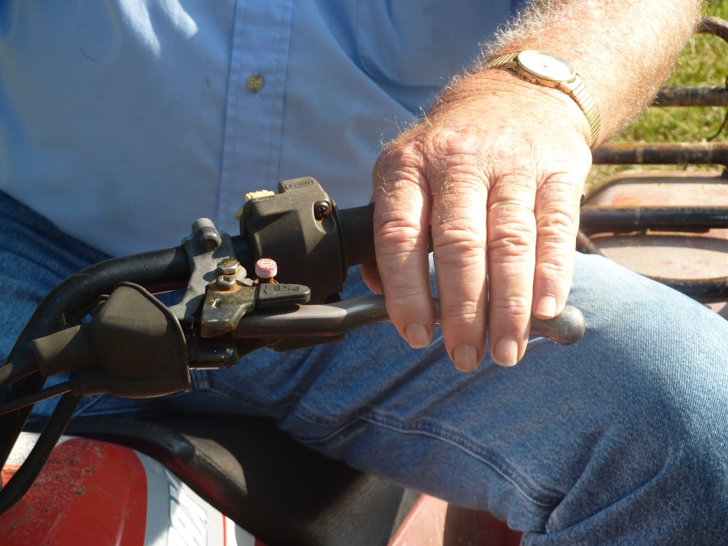
Condition interference with work
Grip strength
Flexibility
Balance recovery
Sensory perception ( hearing and vision)
Decrease distal sensation- Neuropathy

Slide 19
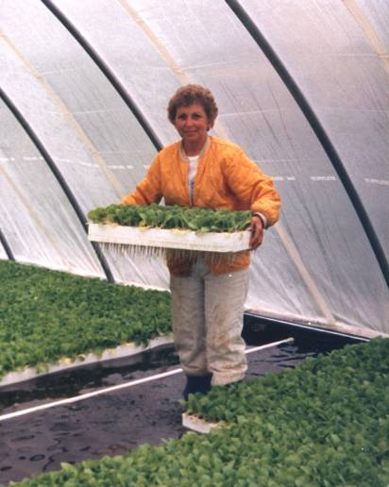
Farm Work Satisfaction
 | < 65 N=749 | 65 - 69 N=267 | 70+ N=407 | Total Sample N=1,423
A great deal | 56.9 | 56.9 | 67.1 | 59.8
Some | 31.2 | 30.8 | 23.5 | 28.9
Very little | 7.2 | 6.7 | 5.0 | 6.5
None | 4.7 | 5.5 | 4.4 | 4.8
Source: Sustained Work Indicators of Older Farmers (Reed)
Notes:
From our study of farmers age 50 and over, it was clearly evident that the participants enjoy their work, Women reported less satisfaction than men. Notice that satisfaction increased with age. This has direct impact on the adherence to medical advice as farmers are reluctant to change work to accommodate treatments, preventive measures, or medication restriction.

Slide 20
Perspectives on Health Status
How would you best define good health? | Under 65 N=749 | 65 - 69 N=267 | 70+ N=407 | Total Sample N=1,423
Absence of pain | 14.5 | 15.3 | 10.9 | 13.7
Ability to work | 39.1 | 40.0 | 41.8 | 40.0
Absence of major disease | 25.4 | 25.5 | 23.4 | 24.9
Not having to take medications | 17.0 | 16.5 | 18.1 | 17.2
Some other definition | 3.9 | 2.8 | 5.9 | 4.2
Reed. D.B., Rayens, M.K., Conley, C., Westneat,S., Adkins, S.M. (2012) Farm elders define health as the ability to work. Workplace Health and Safety , 60(8), 345-351.
Notes:
Unlike the general population, farmers thought more of health as the ability to work, This is consistent with the limited literature from the 80’s that explored this concept. With the exception of “absence of pain” the definitions were fairly consistent across age groups.

Slide 21
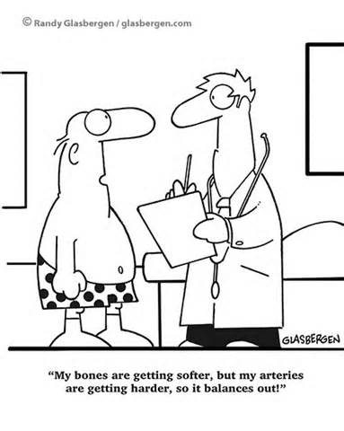

Slide 22
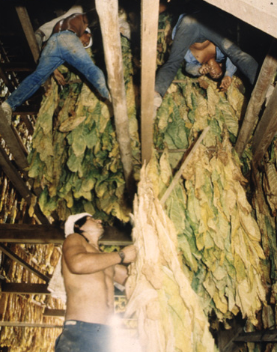
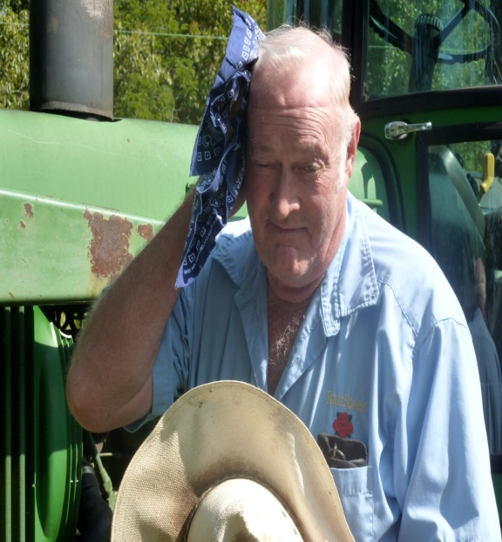

Occupational hazards

Slide 23
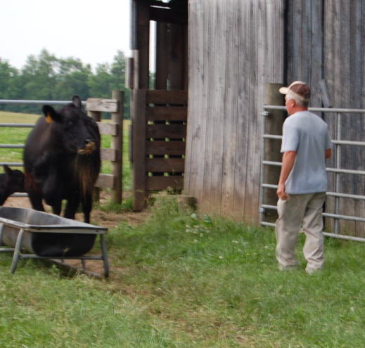

Older Farmers at risk
Slowing reflexes
Physical wasting
Arthritis
Accelerated hearing loss
Cataracts
Skin cancer
Notes:
Older farmers seem to suffer from more debilitating conditions than the general population. Farmers are second only to fisherman for cataracts. Predominant skin cancers are basal cell and malignant melanoma. Hearing loss has been documented in farm teens and is caused by prolonged exposure to loud noises. If you have to raise your voice to be heard 36” away you are damaging your hearing.

Slide 24
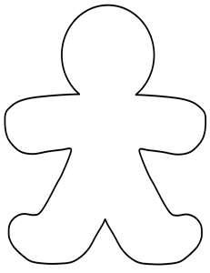
Physiologic Considerations for Older Workers
Processing
Vision
Balance
Hearing
Respiratory function
Musculoskeletal
flexibility
Reaction time

Slide 25
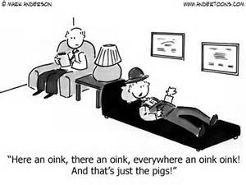
Farming and Health History
Not everything can be attributed to “getting older”
Agriculture has unique health issues not found in other occupations
Critical that medical professionals understand types of work of farmers and their families
Notes:
We can’t run a test for “farming” via a blood sample, but we can assess it through a thorough history.

Slide 26
Tell your provider
What type of farm work do you do
How long has it been since you had a tetanus immunization?
Have you experienced any farm-related injury in the past 5 years?
Are you around loud noises for extended periods of time?
Have you done any new or different farm tasks that might contribute to the current medical problem?

Slide 27

Strategies
Listen to your body
Report any changes to your health care provider
Preventive maintenance:
Flu shot
Pneumonia vaccine
Shingles
Hepatitis A
Tetanus (tDap)
Notes:
Communication and trustworthiness are the primary keys to credibility. It does not require anything high tech. Remember , we have two ears and only one mouth, that means we should listen twice as much as we talk.

Slide 28
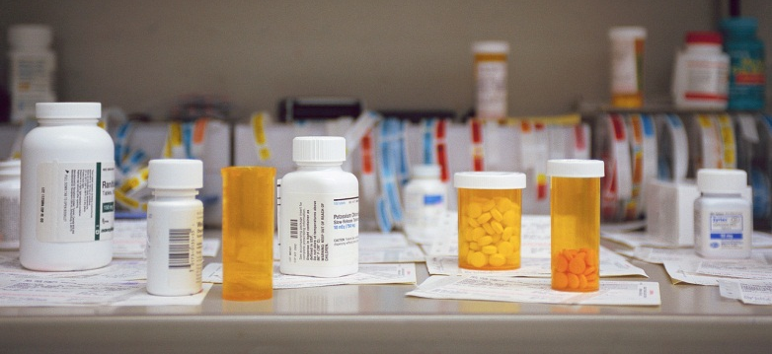
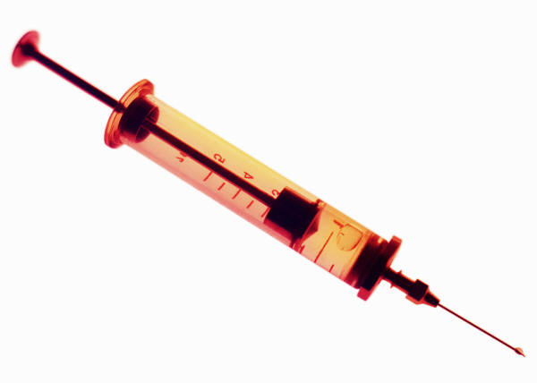
78% of aging farmers reported taking prescription medications on a daily basis
Nearly a third (31%) were not current on tetanus immunization or did not know if they were
Study: Sustained Work Indicators of Older Farmers
Notes:
Now think of the warnings that are included with common medications. Do not operate machinery while taking this medications; this medication may cause drowsiness (or dizziness), Take extra fluids when on this medication….. Now think of the usual day of farmers.
Tetanus is a rare event but a deadly one, with a 46% mortality rate. Soil is heavily contaminated with the tetanus spores, yet one of three farmers did not know their immunization status. Moreover, few health care providers ever ask.

Slide 29
What medications are you taking?
Side effects
Dizziness
Postural hypotension
Dehydration

Slide 30
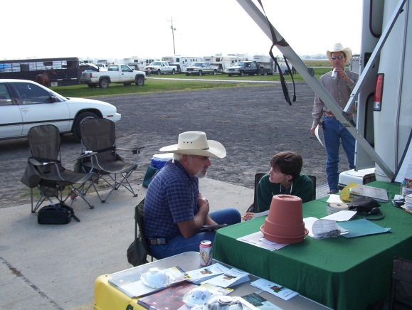
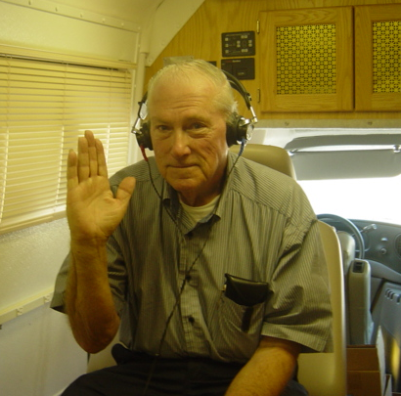
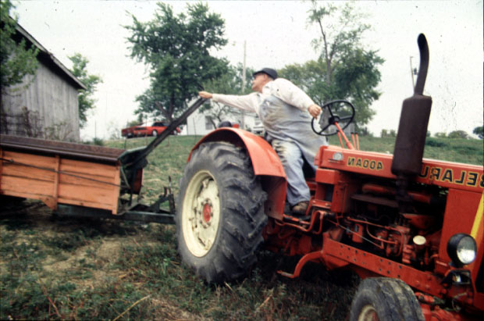
Assessing Physical Risk
Vision/hearing
Balance
Reaction time
Range of motion (neck)
Notes:
It is fairly easy to assess physical risk for farm work of the aging farmer, low or no cost, and as good as fancy tests. The challenge is not being objective about the potential consequences.

Slide 31
Older Farmers at risk
Slowing reflexes
Physical wasting
Arthritis
Accelerated hearing loss
Cataracts
Skin cancer
Notes:
Older farmers seem to suffer from more debilitating conditions than the general population. Farmers are second only to fisherman for cataracts.

Slide 32
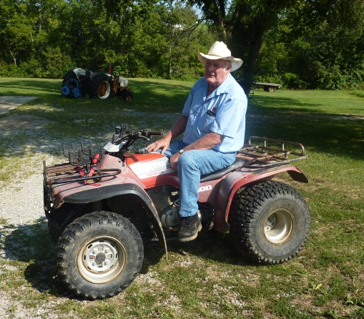
Types of Adaptations
(the farmers)
Use of ATVs and utility vehicles
Increased use of communication devices
physically demanding tasks
Maintain machinery and equipment
Plan your trips (walking) to conserve energy
“A 4-wheeler is better for chasing cows, but watch what you’re doing.”
“Be sure somebody knows where your are.”
Study: Safety Strategies for Older Adult Farmers

Slide 33
Types of Adaptations
(the farmers)
Ease up how much you do; pace yourself
  Don’t get in a hurry; stop and rest
Hire younger people to help do the more physically demanding tasks
Relax – do more away from farm (vacation)
Take nap breaks
“Now I go out to feed at 7, used to go at 5.”
“When I get tired, I quit.”
Study: Safety Strategies for Older Adult Farmers

Slide 34
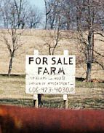
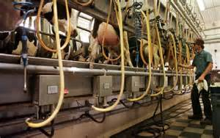
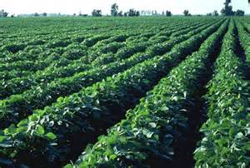
Types of Adaptations
(family members)
What they’ve done
  Selling part of farm to lessen work load
  Changing type of farm (e.g. from dairy to hay/beef cattle operation)
  Keep PTO shields on
  Planning task distribution ahead of time
Study: Safety Strategies for Older Adult Farmers

Slide 35
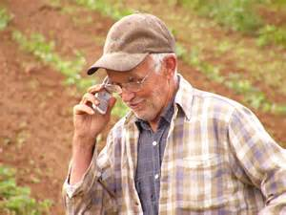
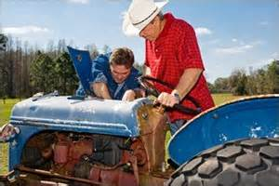
Types of Adaptations
(family members)
What they could do
  Find different tasks that aren’t as risky
  Fix/repair equipment so someone else can do the job instead of the older farmer
  Communication (keep him in sight; check-in)
  Plan A – Plan B

Slide 36

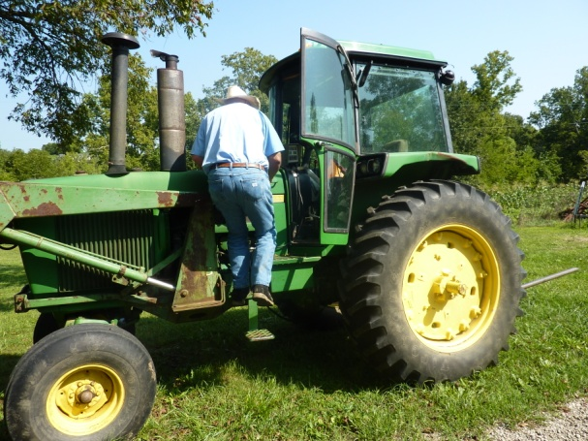
Arthritis resources
CDC web based program on living with arthritis
Arthritis Foundation
National AgrAbility – Arthritis and agriculture

Slide 37
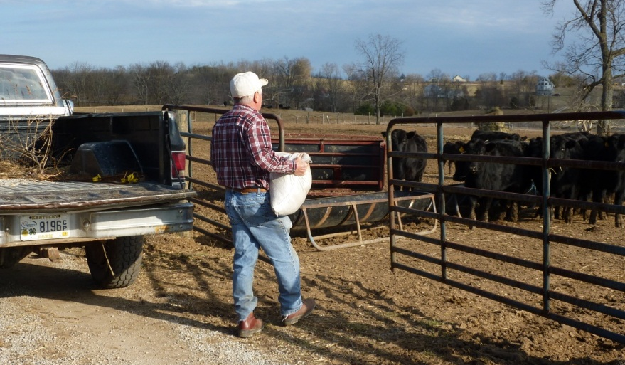
Lessen the load
Lighten the shock
Use smaller buckets
Use a small wagon to transport heavy goods short distances
Move feed troughs closer to fence or walkway
Add bulk to handles (pool noodles or insulation pipe works well)
Add shock absorbing mats/seats to tractors

Slide 38
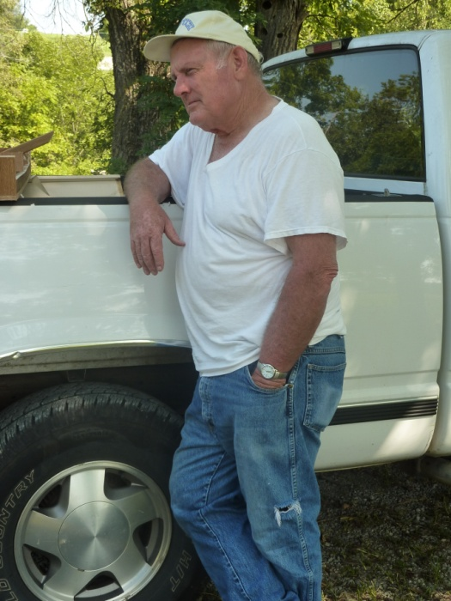
Lessen the load
Get a work dog
Use a walking stick
Stretch out
Keep multiples:
  Tools in truck, tractor and shop
  Keep a list – pencil and paper works fine!
  Accept help; give help

Slide 39
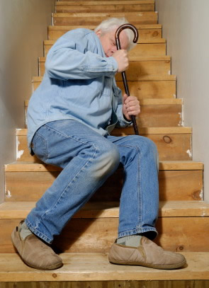


Balance Tests You Can Do at Home
http://www.fit-after-50-womens-health-magazine.com/balance-tests.html
http://www.realage.com/fitness/improve-your-balance

Slide 40
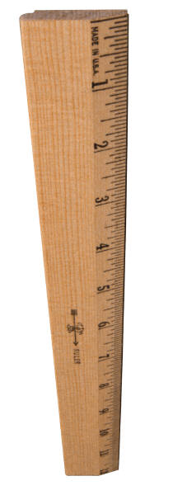
Reaction Time Tests
http://faculty.washington.edu/chudler/chreflex.html (How fast are you?)
http://www.driveractive.com/tips/reaction.html
Notes:
Get a ruler (or a yardstick or candy bar). Hold the ruler near the end (highest number) and let it hang down. Have another person put his or her hand at the bottom of the ruler and have them ready to grab the ruler (however, they should not be touching the ruler). Tell the other person that you will drop the ruler sometime within the next 5 seconds and that they are supposed to catch the ruler as fast as they can after it is dropped. Record the level (inches or centimeters) at which they catch the ruler (you can convert the distance into reaction time with the chart below). Test the same person 3 to 5 times (vary the time of dropping the ruler within the 5 second "drop-zone" so the other person cannot guess when you will drop the ruler). Here is a table to convert the distance on the ruler to reaction time. For example, if you caught the ruler at the 8 inch mark, then your reaction time is equal to 0.20 seconds (200 ms). Remember that there are 1,000 milliseconds (ms) in 1 second.
Distance – Time
2 in (~5 cm), 0.10 sec (100 ms)
4 in (~10 cm), 0.14 sec (140 ms)
6 in (~15 cm), 0.17 sec (170 ms)
8 in (~20 cm), 0.20 sec (200 ms)
10 in (~25.5 cm), 0.23 sec (230 ms)
12 in (~30.5 cm), 0.25 sec (250 ms)
17 in (~43 cm), 0.30 sec (300 ms)
24 in (~61 cm), 0.35 sec (350 ms)
31 in (~79 cm), 0.40 sec (400 ms)
39 in (~99 cm), 0.45 sec (450 ms)
48 in (~123 cm), 0.50 sec (500 ms)
69 in (~175 cm), 0.60 sec (600 ms)

Slide 41
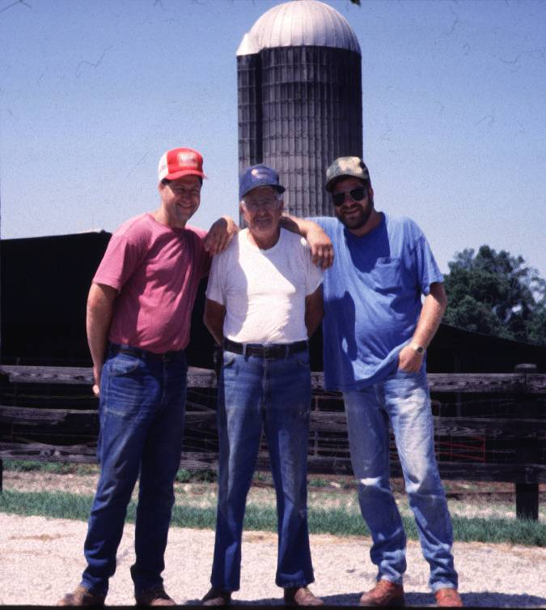
WORK AND ITS MEANING
To be a farmer is to “carry on the family tradition”
To be a farmer is to become part of the land itself
Farming and farm work is a part of the self-identity
Notes:
Farmers have their self-identity in the work they do and the land they work on. Not tending the land would be like abandoning one’s own child. The production of their work is self-evident and tangible not only through economics but through all the senses. One can see clean fencerows, smell the crops as they ripen, and taste the produce. The work sustains your family nutritionally, economically, and spiritually, but only because you are a careful steward of the land. How can you trust this important work to anyone but yourself?

Slide 42
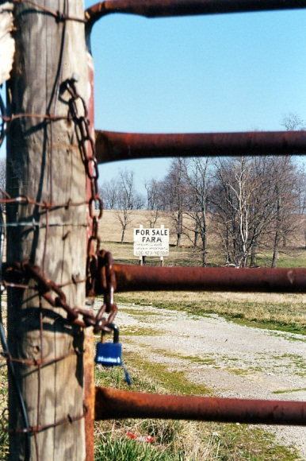
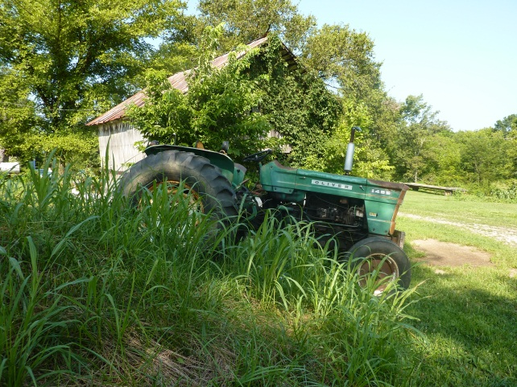
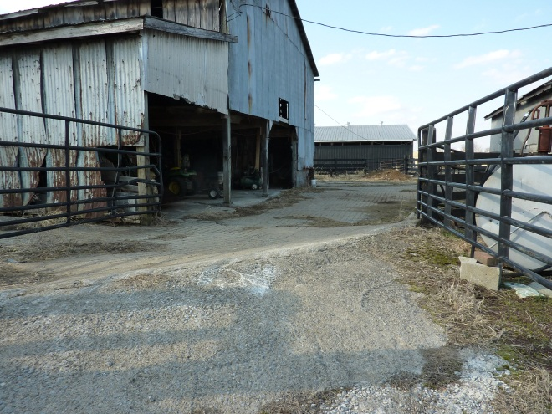
Farmers and Depression
Farmers have one of the highest suicide rates of any occupation
Peaks at oldest ages
Males are at higher risk than females
Browning, S.R., Westneat, S.C., & McKnight, R.H. (2008). Suicides among farmers in three southeastern states, 1990‐1998. Journal of Agricultural Safety and Health, 14(4): 461-472.
Notes:
This slide is usually a shocker. But think about watching your farm go downhill and you no longer able to keep it pristine. Older farmers tend to remain in the farm homestead, even after passing the work along to someone else. Sitting at the window can take a tremendous emotional toll. “This is what I’ve worked for, this is who I am .”

Slide 43
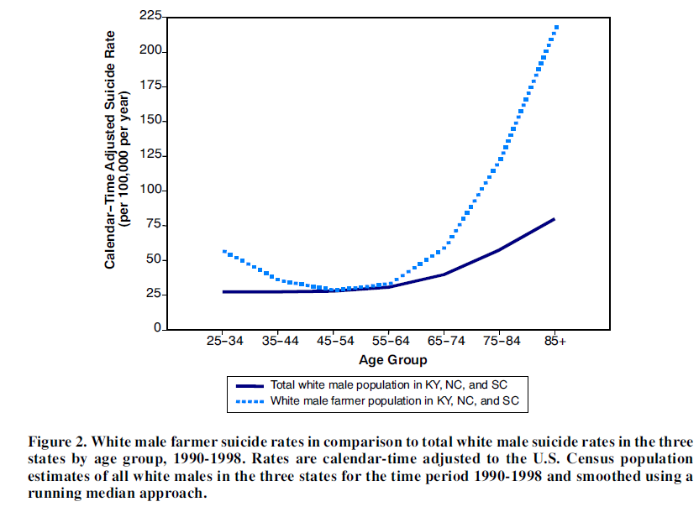
Suicide rates by age groups
Source: Browning, Westneat, & McKnight, 2008
Notes:
Browning, S. R., Westneat, S. C., & McKnight, R. H. (2008). Suicides among farmers in three southeastern states, 1990-1998. Journal of Agricultural Safety and Health, 14(4), 461-472.

Slide 44
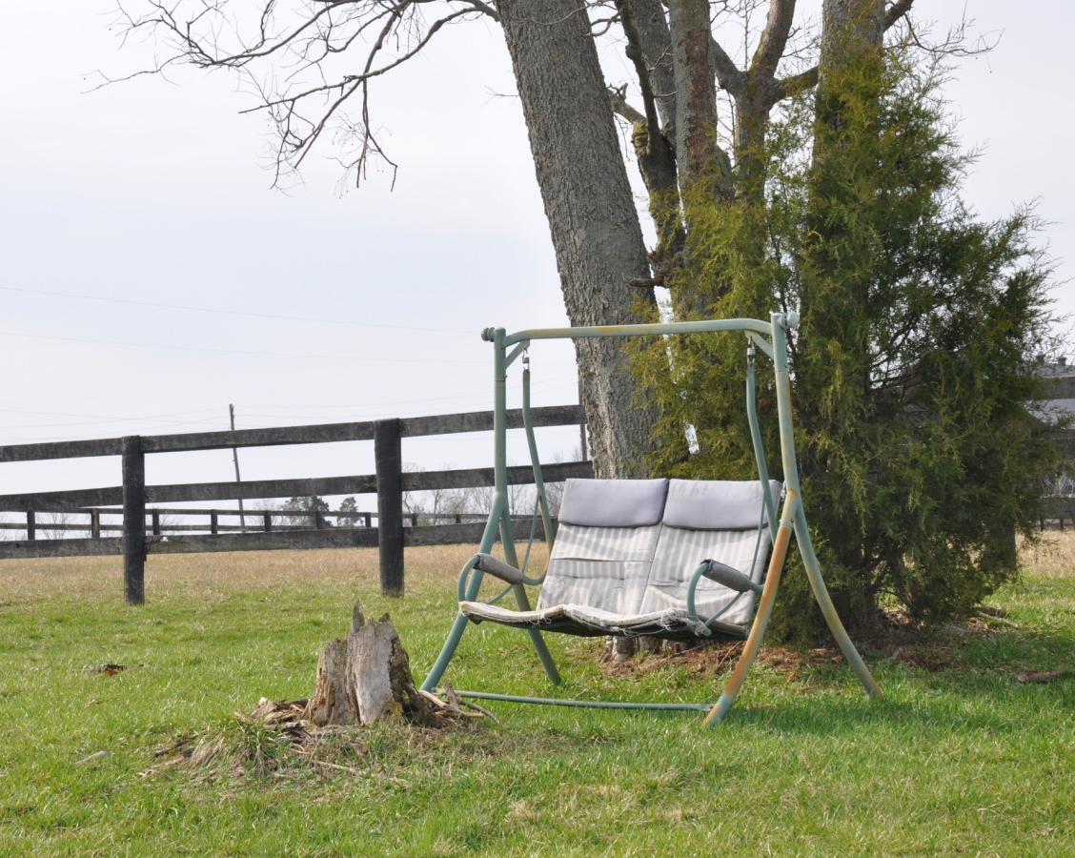
Loss of Family Member
“I think the thing that maybe has been the hardest for me is... making decisions... for over 50 years you’ve had someone to talk things over with and now you have to make a decision by yourself.” Comments of a 77 year old farm widow (Scheerer and Brandt, 2001).
Notes:
“I think the thing that maybe has been the hardest for me is... making decisions... for over 50 years you’ve had someone to talk things over with and now you have to make a decision by yourself.” Comments of a 77-year-old farm widow. (Scheerer & Brandt, 2001)
The world of the aging farmer includes more concerns than just the farm. Loss of a spouse is the greatest stressor in life. This quote is not unusual for older farmers as women generally outlive their spouse. Since selling land is unthinkable, the widow is left with the tremendous task of the business. The greatest increase in producers is older females. (USDA, 2009) Very little research has been examined regarding the particular health risks of women left to operate the farm after the death of a spouse. Males, too, suffer tremendously from the loss of a partner – coming in from work to an empty house further heightens a farmer’s feeling of isolation. Farming is a family enterprise, a partnership, even if one member never physically labors – that person is a sounding board for the events of the day, a companion.
.

Slide 45
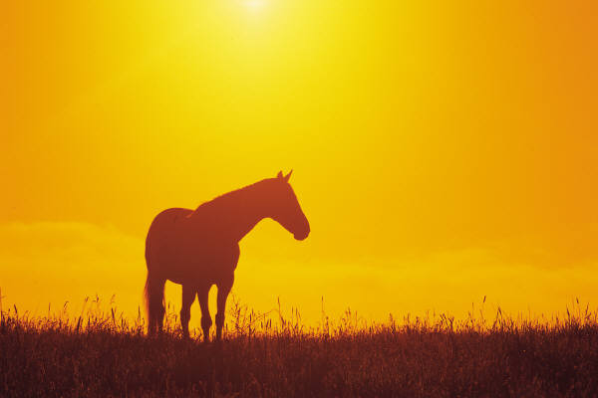
“People have asked me over the years why I haven’t quit doing horses since I’ve been hurt so much. It’s something you love to do. We’re all going to die. I would rather die doing what I love to do than die in a nursing home… I know it sounds crazy,
but when you love something that much, you don’t give it up. You just try to be more wise about what you do.”

Slide 46
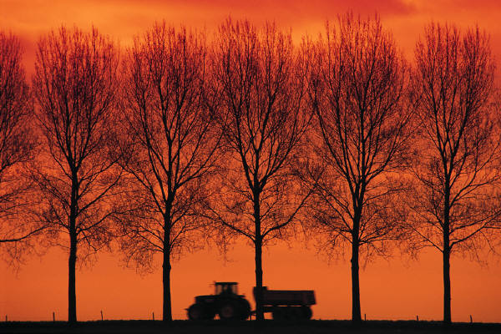

So Why Farm?
“I can’t imagine not farming.
I’d rather die than not farm…”
Notes:
Just as DNA Ancestry .com can track your ethnic heritage, scientists have also discovered markers for career heritage, which they claim influences the career path you choose.

Slide 47
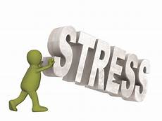
Physiologic factors that increase stress
Hearing loss
Fatigue
Cardiovascular disease (including hypertension)
Dehydration

Slide 48
STRESS
CVD
Impaired cognitive function
Diabetes
Chronic immunosuppression
Inflammatory response
↑ abdominal fat
↑ blood pressure
↑ blood sugar
immunosuppression
↑ C-reactive protein
Cortisol
(adrenal cortex)
TIME
TIME
↑ energy
↑ memory
↓ pain
↑ immunity
Relaxation
Return to normal levels

Slide 49
So, how did the conversation go with your Dad about him giving up the keys to the tractor? “It was the hardest thing I ever had to do.”
“We have abused our bodies doing farm work. We had to prove ourselves when we were young. We need to learn to slack off a bit but that’s not how we were brought up.”
“These younger ones need to be careful what they tell us to do. Putting us on tractors to mow banks is probably the worst thing we can do. That’s how we get killed.”
“I think as you get older the more important it is to just be able to accomplish something.”
“That’s one thing, if you take their freedom away, you break an old farmer’s spirit just like that.”

Slide 50

Agri-safe
http://www.agrisafe.org/
A non-profit national organization
Represents health professionals and educators concerned about the health & safety of farm families
Services include:
  Continuing educators via workshops and webinars
  Technical assistance
  Clinical services
  Network opportunities with other clinicians and experts in the field
  Updates of the most cutting-edge developments in agricultural health and safety
Notes:
Annual membership is $50

Slide 51
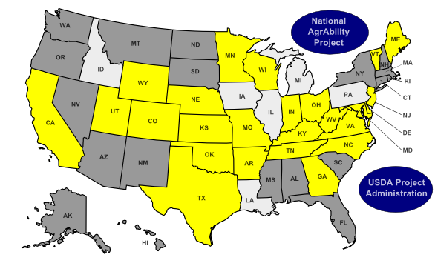
AgrAbility
USDA project
Currently serving 24 states
Mission
  To enable a lifestyle of high quality for farmers, ranchers, and other agricultural workers with disabilities, so that they, their families, and their communities continue to succeed in rural America..
Notes:
http://agrability.org/About-AgrAbility/about.cfm
While the term "disability" often brings to mind conditions such as spinal cord injuries and amputations, AgrAbility addresses not only these but also many other conditions, such as arthritis, back impairments, and behavioral health issues.

Slide 52
AgrAbility Virginia
www.agrability.ext.vt.edu
Toll free: 800.365.1656

Slide 53
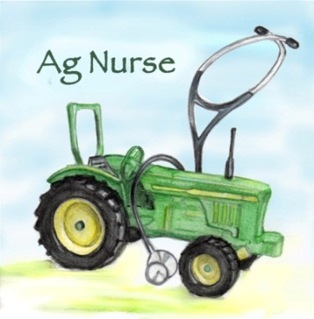
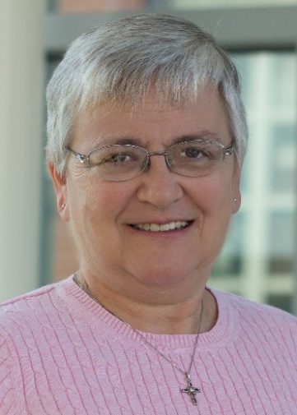
NURSE-AP
JOIN US ON FACEBOOK
http://www.facebook.com/Agriculture.nurse
OR dbreed01@uky.edu
Advancing agricultural health and safety through emerging education and communication strategies,
new clinical interventions,
service learning,
and community collaborations
Notes:
Addresses barriers to optimal care created by delayed access to agricultural health and safety research; lack of evidence-based nursing practice tailored to local farm communities; and the limited number of nurses with expertise in agricultural health and safety

